Slide 1
HARDWARE FUNDAMENTALS
GROUP 6
BINDU SHREE
10/4/2018

Slide 2
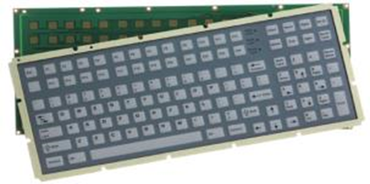
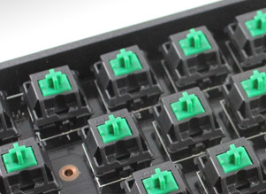
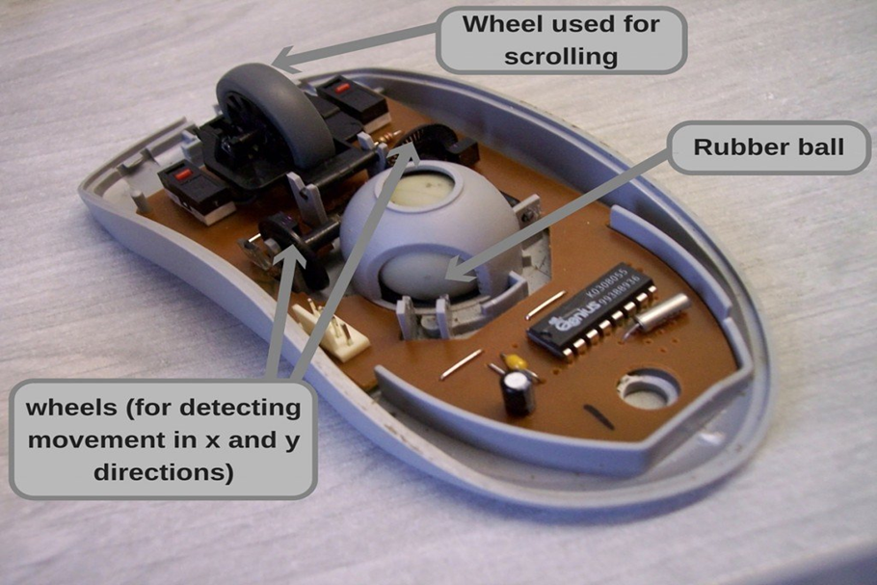
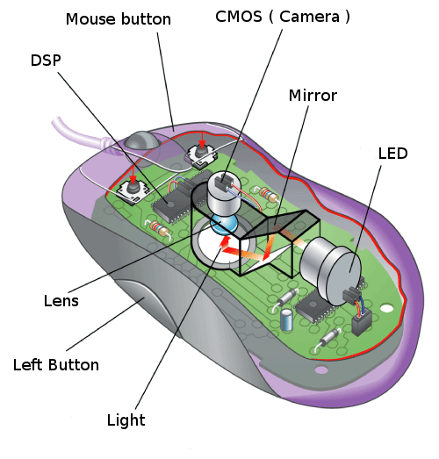
INPUT DEVICES:
KEYBOARD
MEMBRANE KEYBORAD
MECHANICAL KEYBOARD
MOUSE
OPTICAL MOUSE
MECHANICAL MOUSE

Slide 3
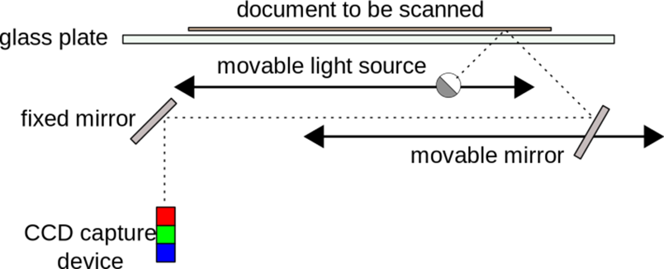
SCANNER
Working of flatbed scanner
Types:
Flatbed scanner
Handheld Scanner
Sheet fed Scanner
Drum Scanner

Slide 4
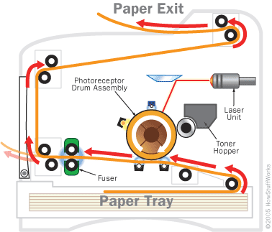
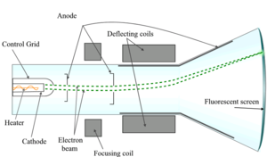
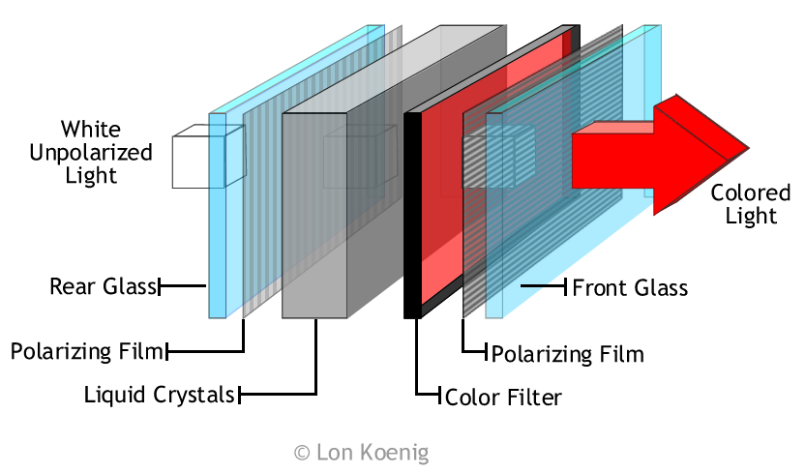
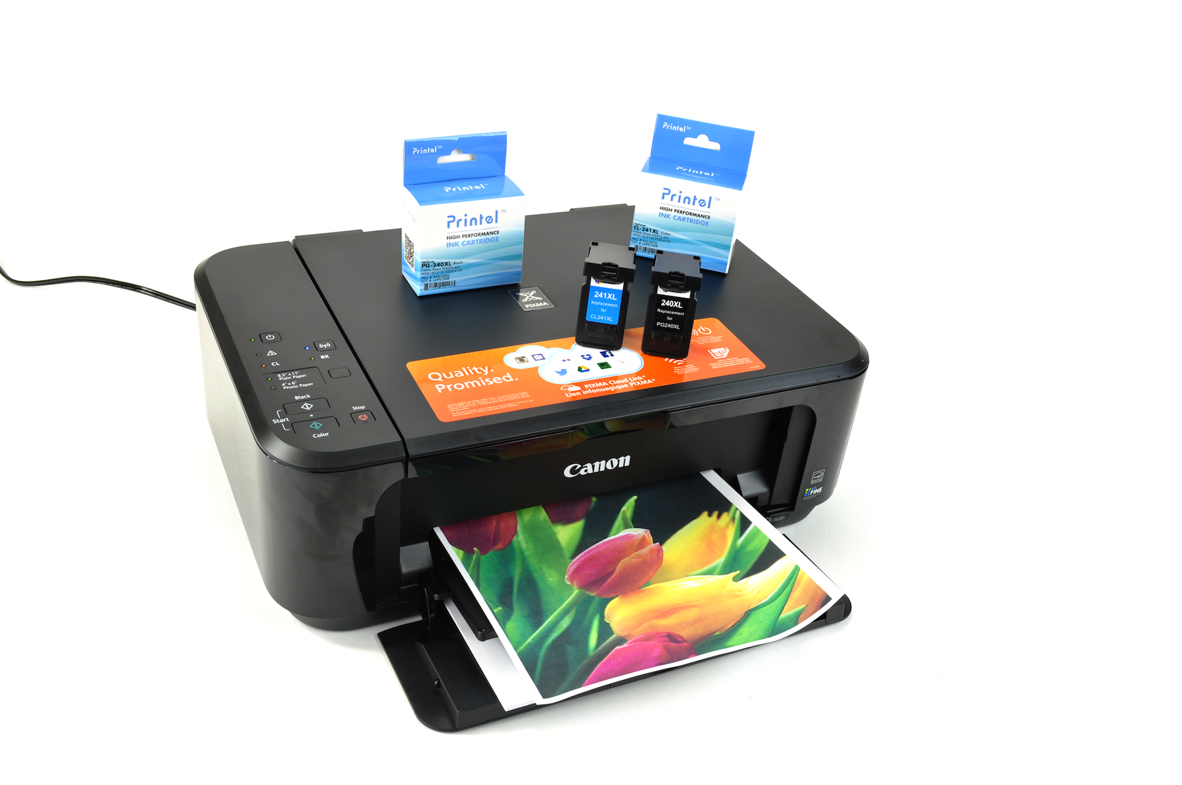
OUTPUT DEVICES
PRINTERS
MONITOR
CRT
LASER PRINTER
INKJET PRINTER
LCD MONITOR

Slide 5
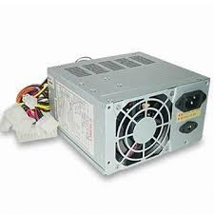
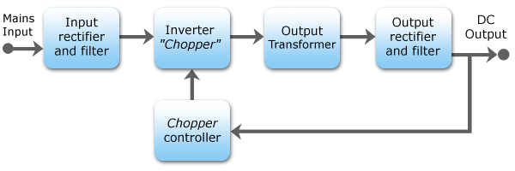
SMPS(SWITCH MODE POWER SUPPLY)

Slide 6
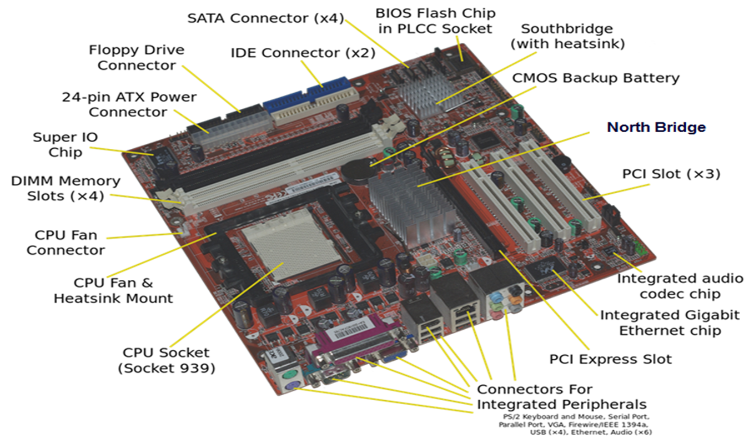
MOTHERBOARD

Slide 7
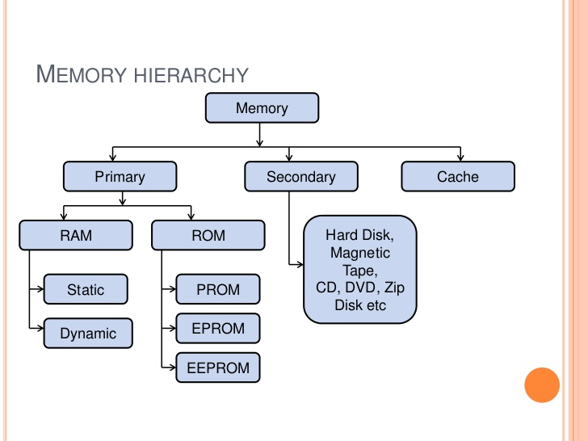
MEMORY

